Slide 1
Bitcoin Calibration and Option Pricing System
董夢雲、吳秉謙、林宏維

Slide 2
董夢雲
昀騰金融科技公司技術長
台灣大學財務金融研究所兼任教授級專家
吳秉謙
台積電 製程整合工程師
中國信託銀行 資本市場業務分析師
國立政治大學 財務管理學系研究助理
林宏維
台灣金融研訓院2022菁英講座
台灣國立師範大學 物理學系研究助理
國泰世華銀行 財務工程研究員
台灣國立師範大學 物理學系碩士

Slide 3

Bitcoin
Decentralized digital currency
Cryptocurrency based on blockchain
6 Main Exchanges:
Bitfinex, Bitstamp, GDAX, Gemini, Itbit and Kraken
Options traded are European style and cash-settled
Bitcoin, while USD acts as the numeraire

Slide 4
Derivative
Market
Intermediation
Spot
Investor
Maybe the cryptocurrency derivatives market is feasible

Slide 5
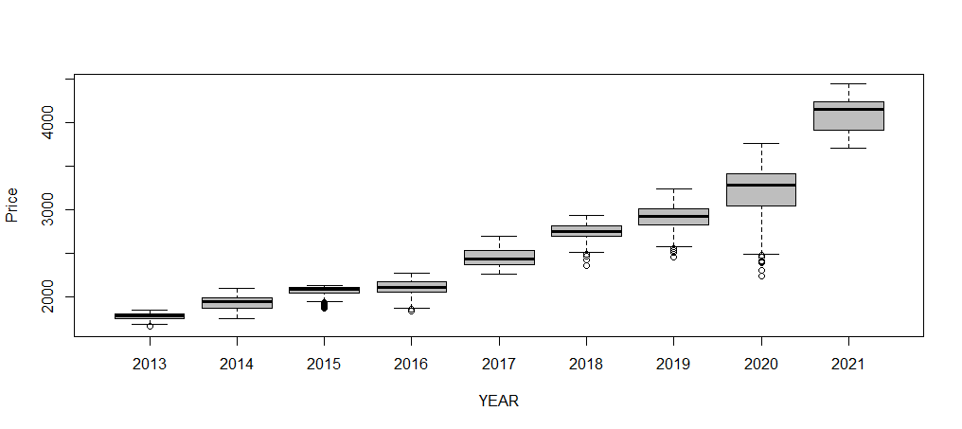
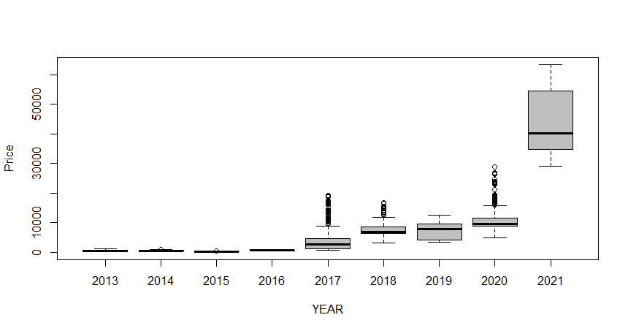
BTC vs S&P 2013 ~ 2021
S&P
BTC

Slide 6
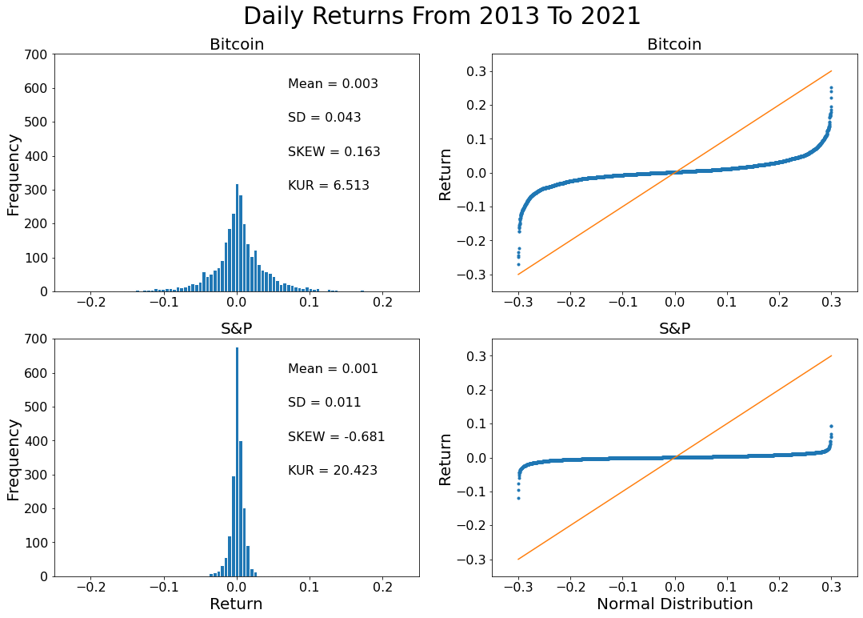

Slide 7
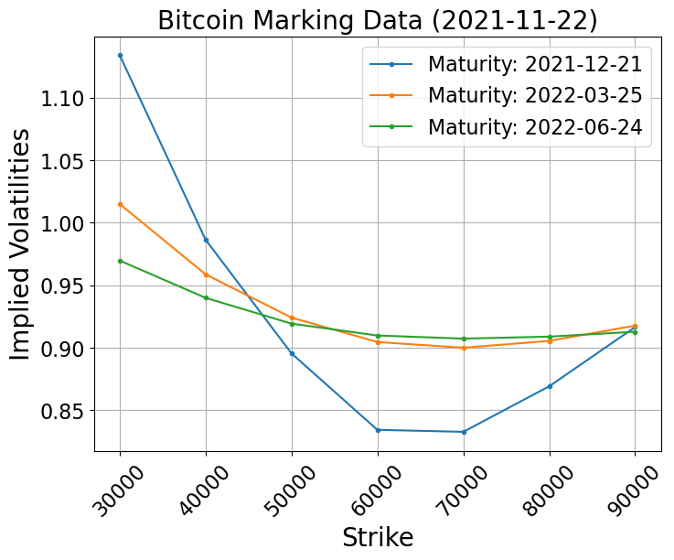
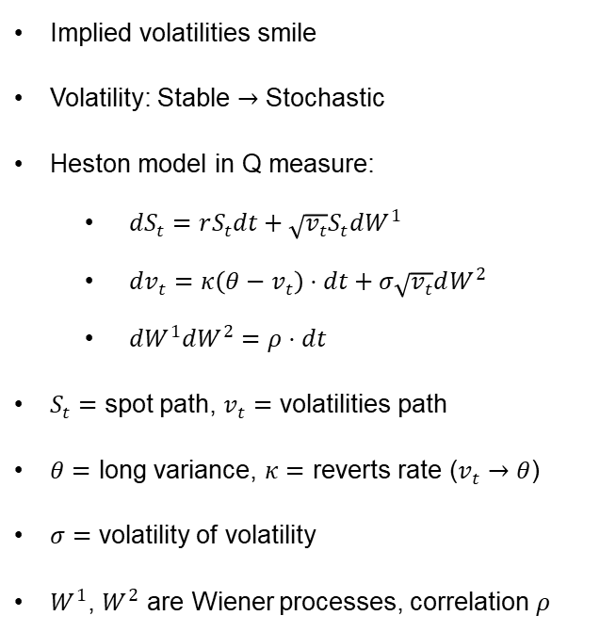
Option Model
Black-Scholes Model
Heston Model
Implied volatilities smile
Volatility: Stable $→$ Stochastic
Heston model in Q measure:
$dS_{t}=rS_{t}dt+\sqrt{v_{t}}S_{t}dW^{1}$
$dv_{t}=κ\left(θ−v_{t}\right)⋅dt+σ\sqrt{v_{t}}dW^{2}$
$dW^{1}dW^{2}=ρ⋅dt$
$S_{t}=$ spot path, $v_{t}=$ volatilities path
$θ=$ long variance, $κ=$ reverts rate ($v_{t}→θ$)
$σ=$ volatility of volatility
$W^{1}$, $W^{2}$ are Wiener processes, correlation $ρ$

Slide 8
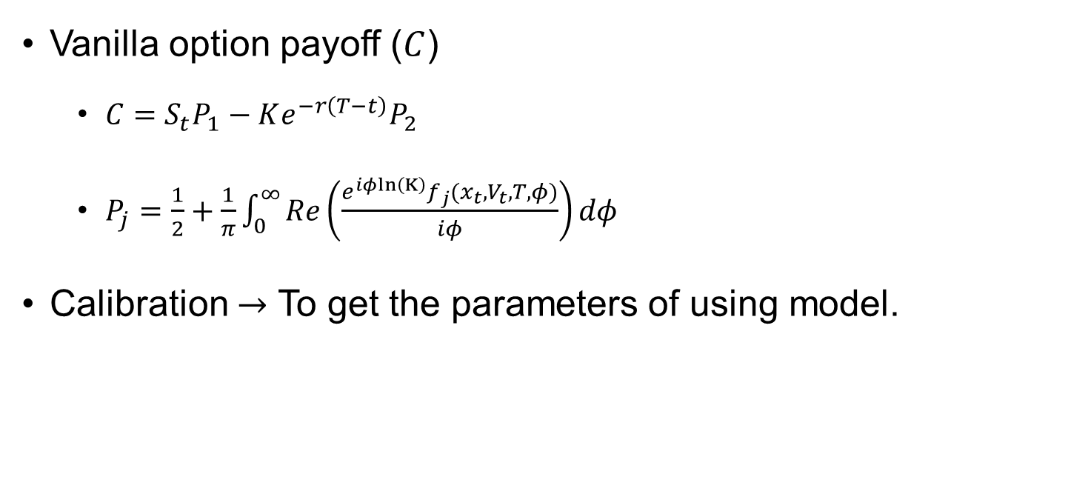
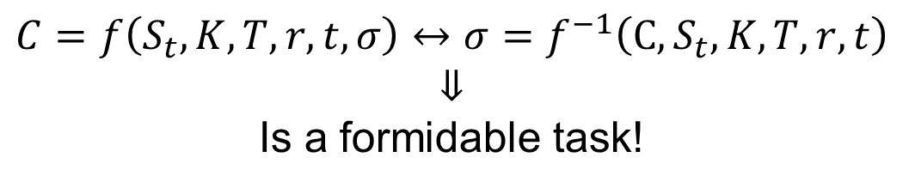
Calibration
Market Price
Implied Volatility
Vanilla option payoff ($C$)
$C=S_{t}P_{1}−Ke^{−r\left(T−t\right)}P_{2}$
$P_{j}=\frac{1}{2}+\frac{1}{π}\int_{0}^{∞}{Re\left(\frac{e^{iφln\left(K\right)}f_{j}(x_{t}, V_{t}, T,φ)}{iφ}\right)dφ}$
Calibration $→$ To get the parameters of using model.
$$C=f\left(S_{t}, K,T,r,t,σ\right)↔σ=f^{−1}\left(C, S_{t}, K,T,r,t\right)$$
$$⇓$$
Is a formidable task!

Slide 9
QuantLib
IR
EQ
FX
Model Calibration
CR
CMDTY
INF
Curve Construction
With QuantLib, financial calculations become feasible and robust.
Written in C++, through SWING technology to use in python

Slide 10
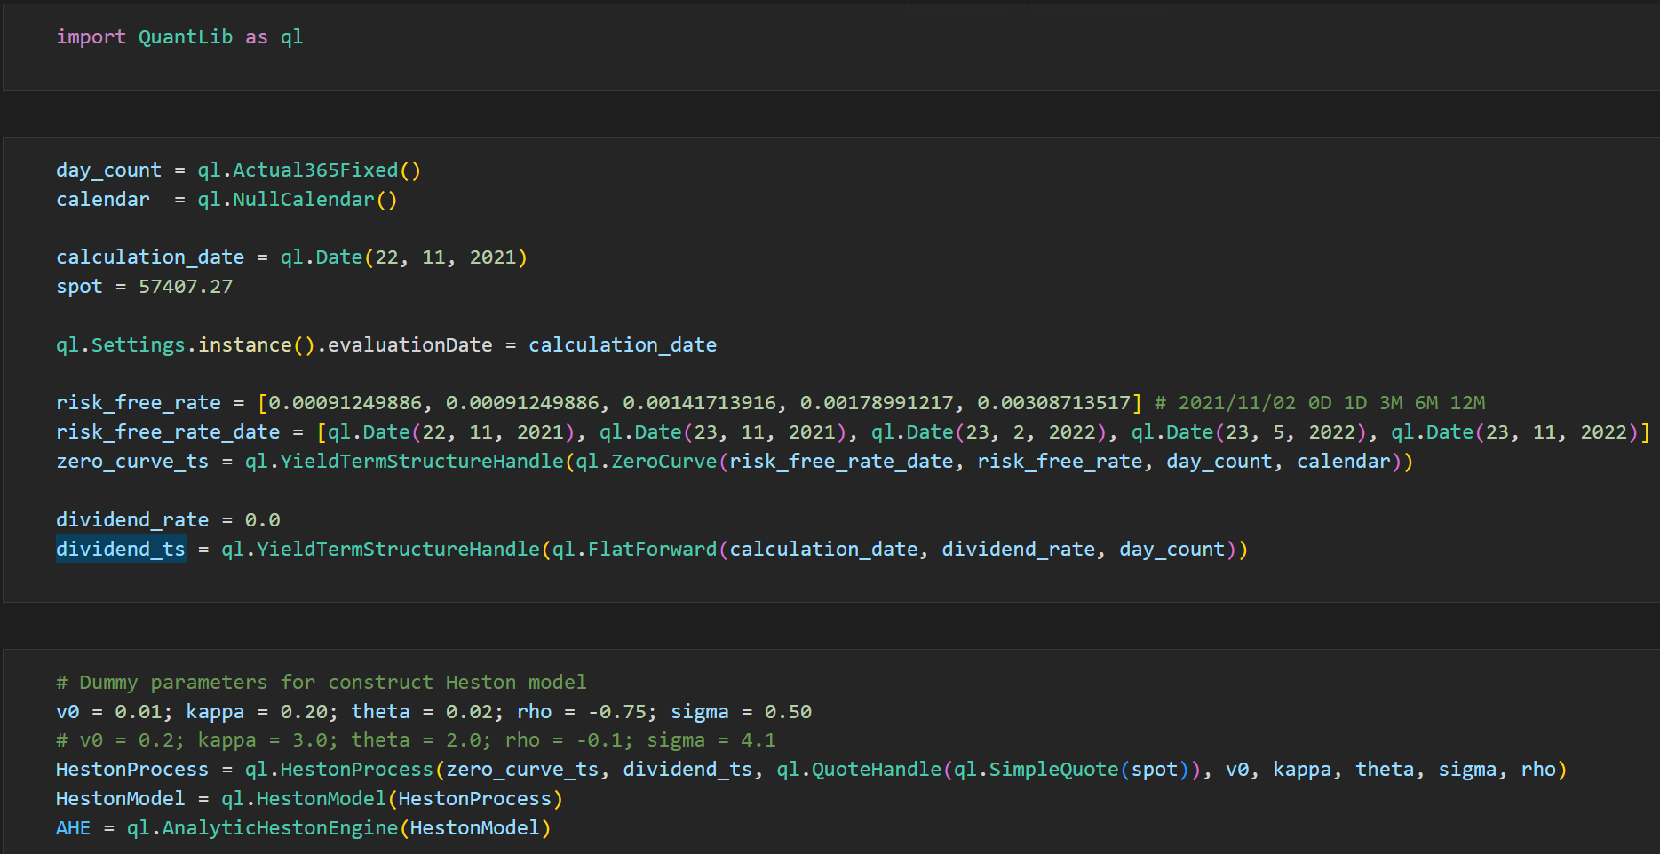
Calibration

Slide 11
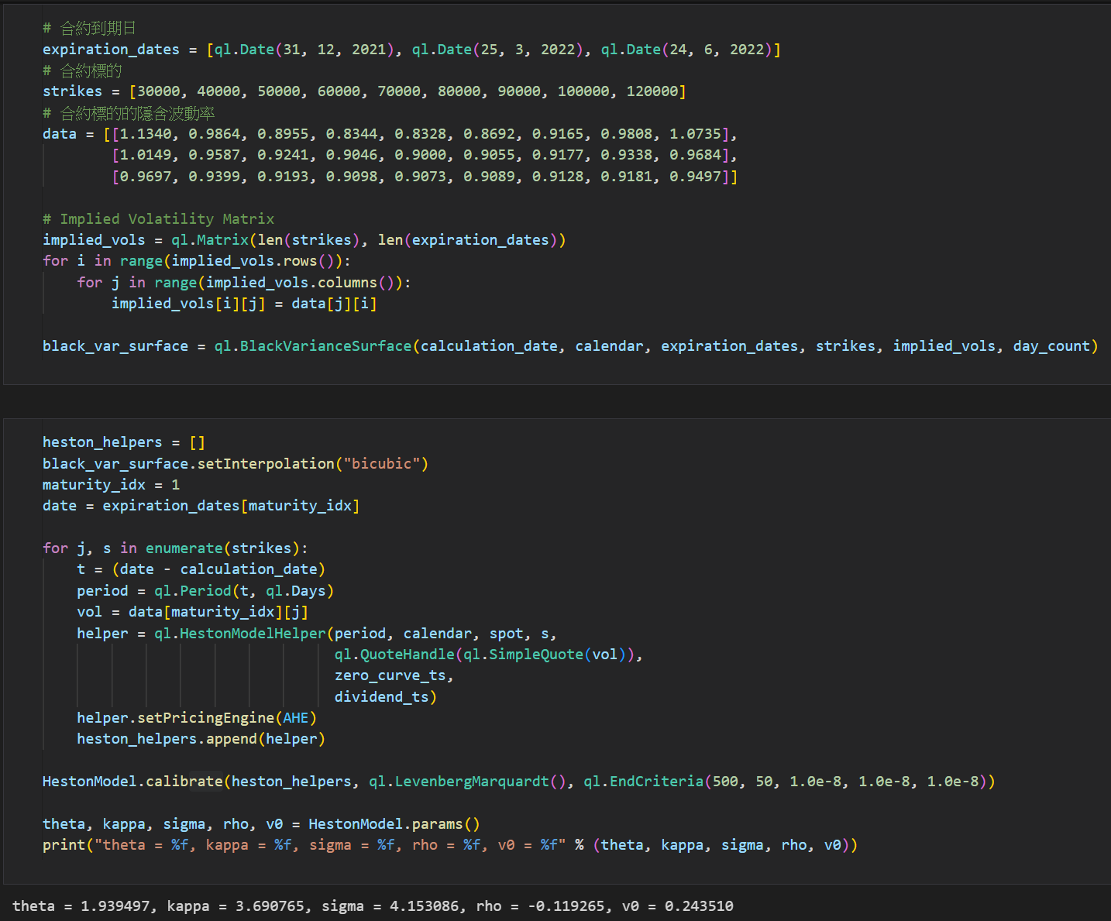

Slide 12
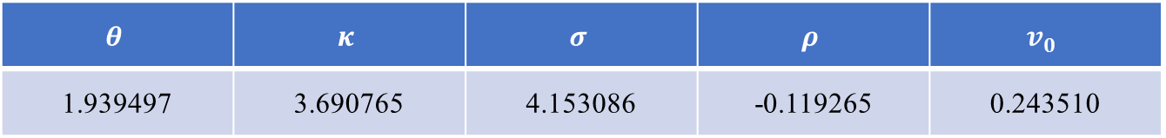
Calibration
Strikes\Maturity | 2021 - 12 - 31 | 2022 - 03 - 25 | 2022 - 06 - 24
30000 | 1.1340 | 1.0149 | 0.9697
40000 | 0.9864 | 0.9587 | 0.9399
50000 | 0.8955 | 0.9241 | 0.9193
60000 | 0.8344 | 0.9046 | 0.9098
70000 | 0.8328 | 0.9000 | 0.9073
80000 | 0.8692 | 0.9055 | 0.9089
90000 | 0.9165 | 0.9177 | 0.9128
$$θ$$ | $$κ$$ | $$σ$$ | $$ρ$$ | $$v_{0}$$
1.939497 | 3.690765 | 4.153086 | -0.119265 | 0.243510

Slide 13
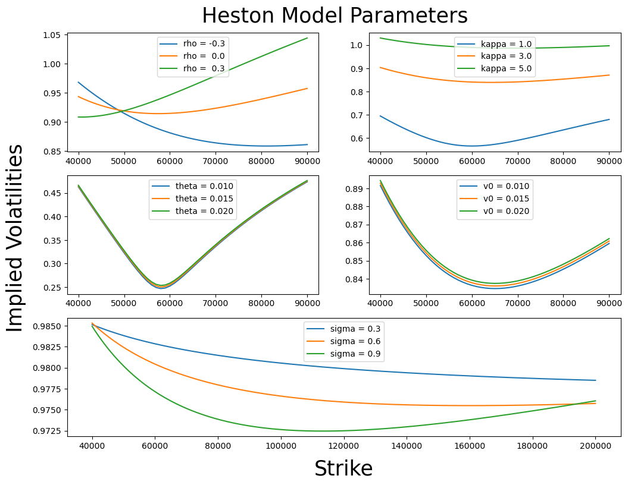

Slide 14
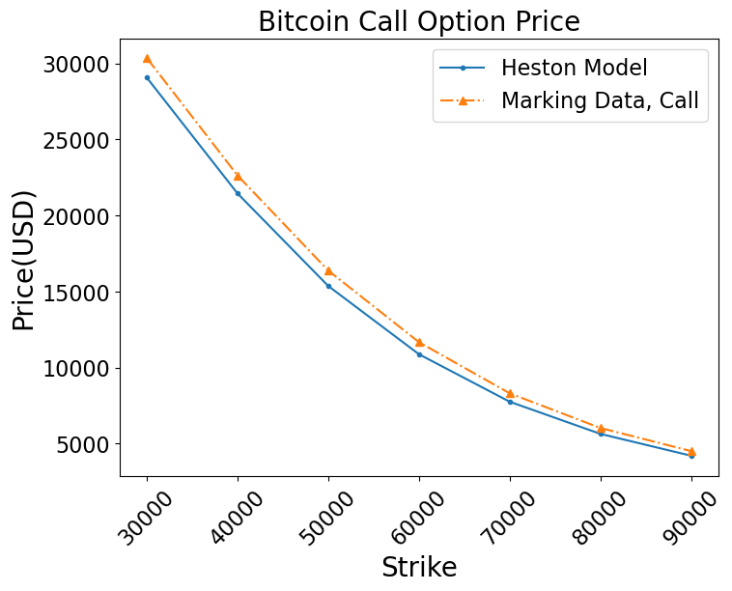

Slide 15
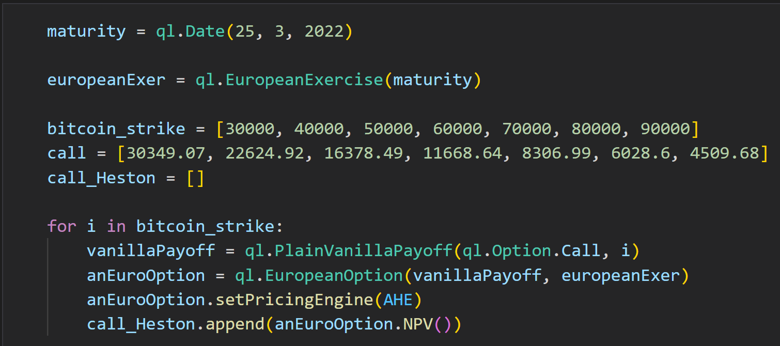
Marking Data vs Heston Model
Strikes | Marking Data | Heston Model | Relative Error(%)
30000 | 30349.1 | 29056.1 | -4.26
40000 | 22624.9 | 21443.0 | -5.22
50000 | 16378.5 | 12361.8 | -6.21
60000 | 11668.6 | 10875.2 | -6.80
70000 | 8306.9 | 7754.9 | -6.65
80000 | 6028.6 | 5640.8 | -6.43
90000 | 4509.7 | 4205.5 | -6.75
Avg |  |  | 6.05

Slide 16
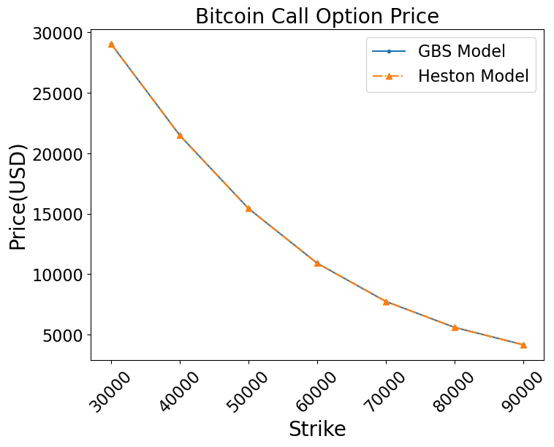
Black - Scholes vs Heston

Slide 17
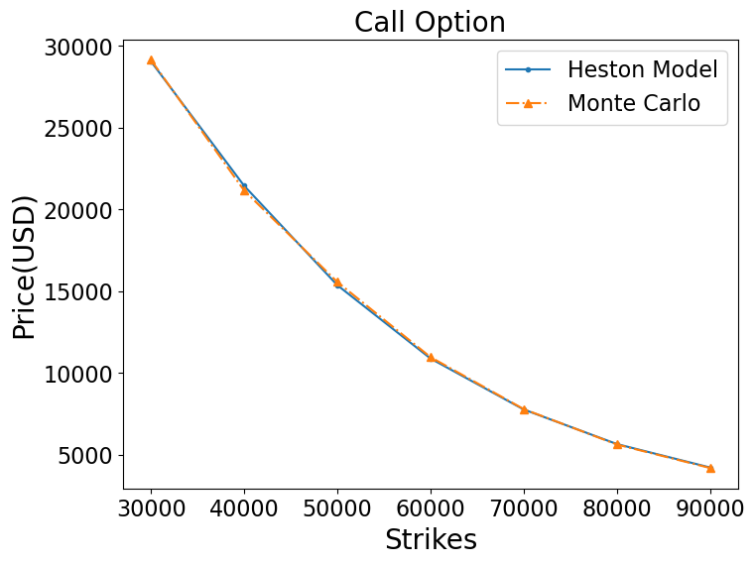
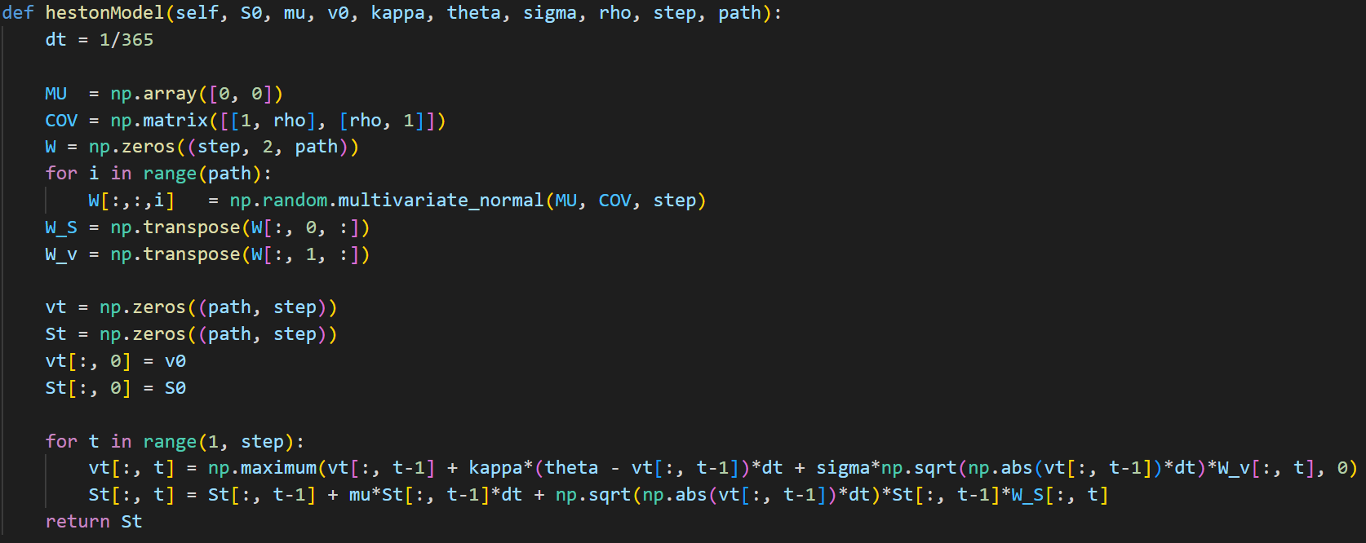
Monte Carlo Simulation
Average Error: 0.74%

Slide 18
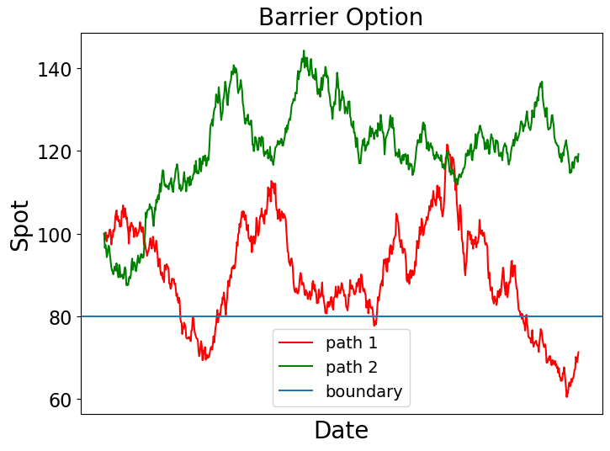
Exotic Option

Slide 19
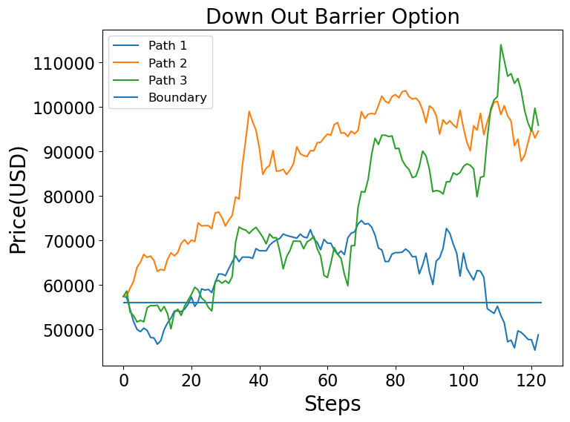

Slide 20
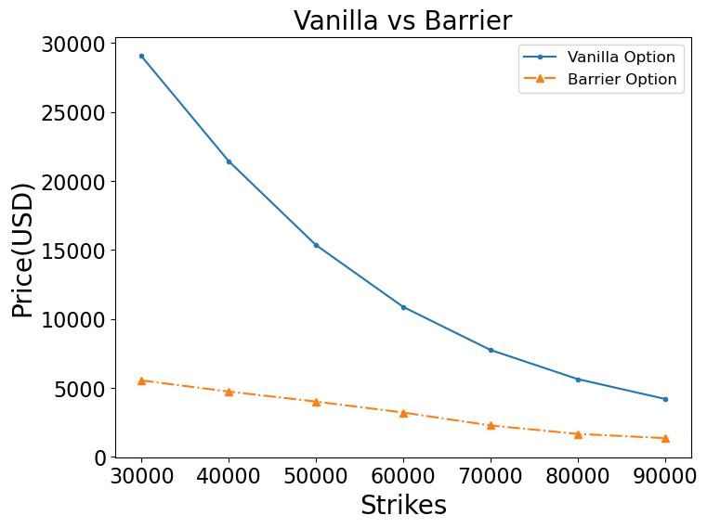

Slide 21
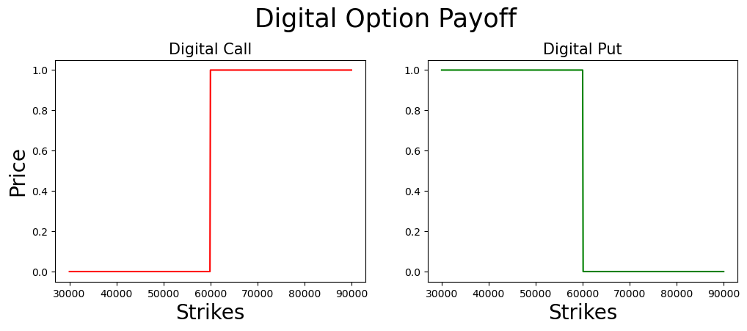
Exotic Option

Slide 22
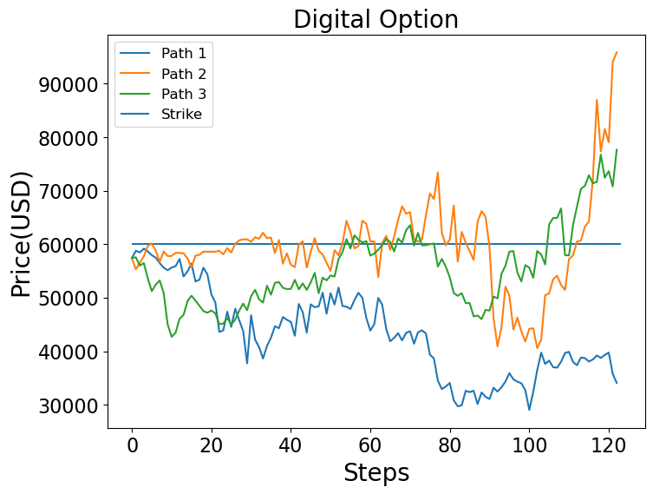

Slide 23
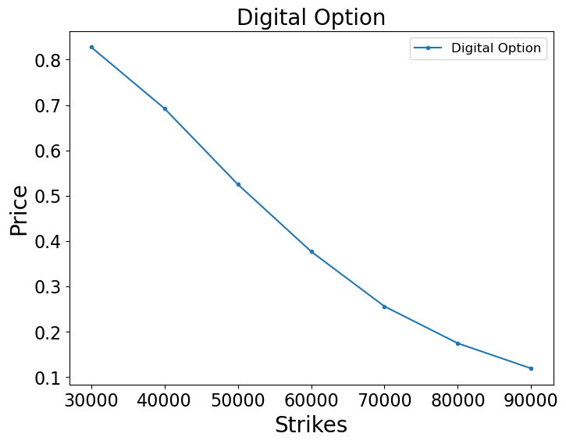

Slide 24
PyQt5
Stable GUI Solution
Developer : Riverbank Computing
Authorize for free software use
Developing by Graphic environment
Plentitude of online resources
QT user can painlessly swift to PyQt

Slide 25
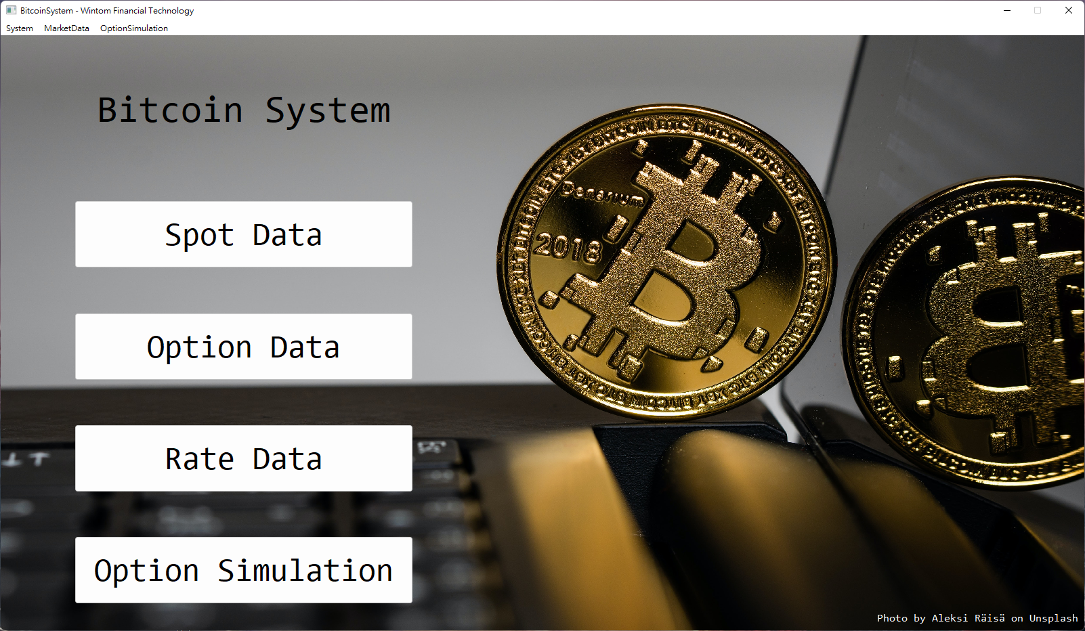
Main Window

Slide 26
MainWindow
MainWindow.setWindowTitle()
MainWindow.menuBar()
QVBoxLayout()
QPalette().setBrush(QPalette.Background, QBrush(fig))
QLabel()
QPushButton()
QPushButton().clicked.connect(QAction())
QPushButton()
function
QPushButton()
QPushButton()
QVBoxLayout().addWidget()

Slide 27
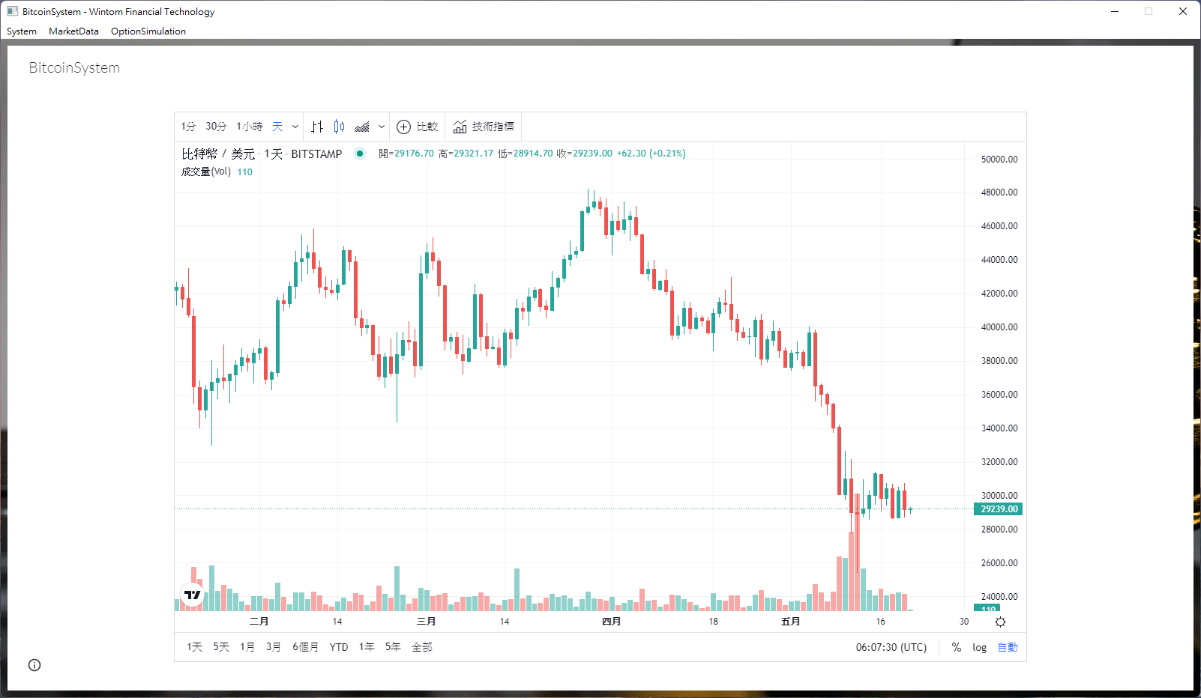
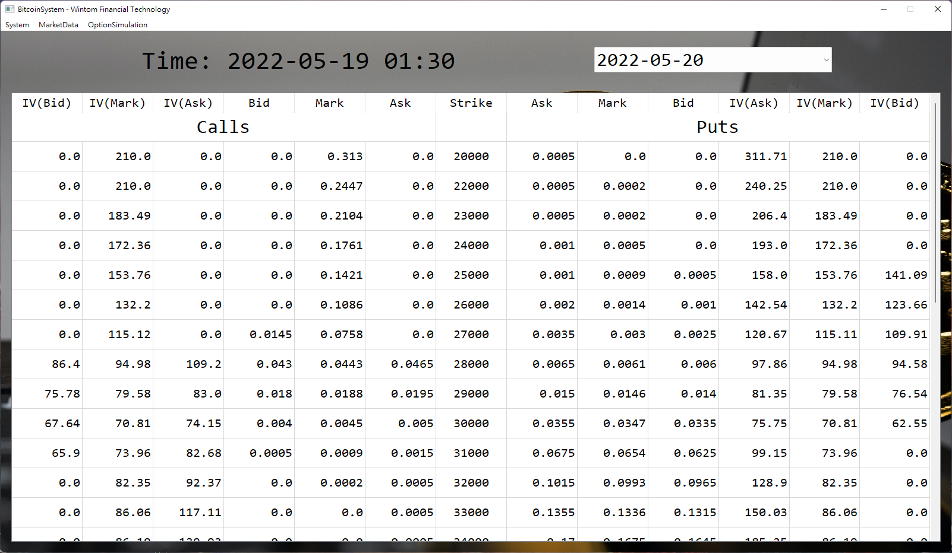
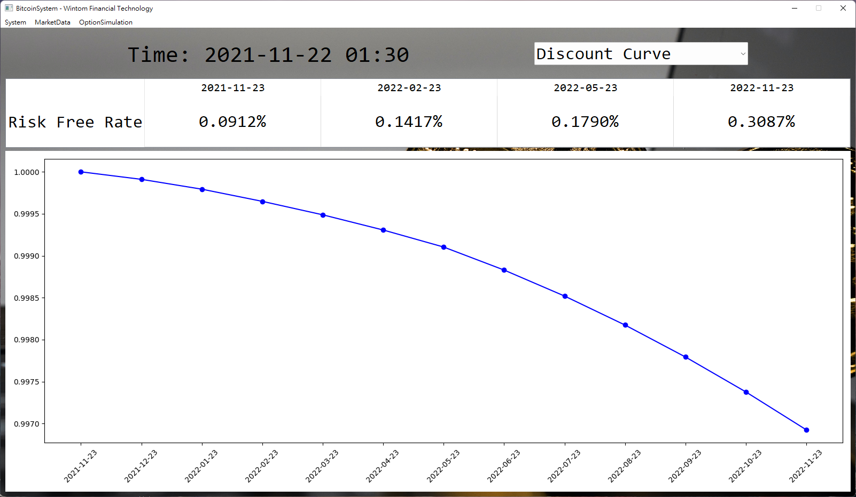
Stacks

Slide 28
Window title
Menu bar
QStackWidget().addWidget(Stack1)
QStackWidget().addWidget(Stack1)
QStackWidget().addWidget(Stack3_Option)
QStackWidget().addWidget(Stack4_Rate)
QStackWidget().addWidget(Stack1)
QVBoxLayout()
QStackWidget().addWidget(Stack2_Spot)
QLabel()
QCombobox()
QLabel()
QCombobox()
QStackWidget().addWidget(Stack1)
QLabel()
Stacks for option with different maturity
QTableWidget()
Stacks for option with different maturity
Stacks for option with different maturity
QTableWidget
QPushButton()
Stacks for different curve
FigureCanvas(matplotlib.pyplot.figure())
Stacks for different curve
QPalette()
QPushButton()
QStackWidget().addWidget(Stack1)
Stack2.addWidget(QWebEngineView())
QPushButton()
QPushButton()

Slide 29
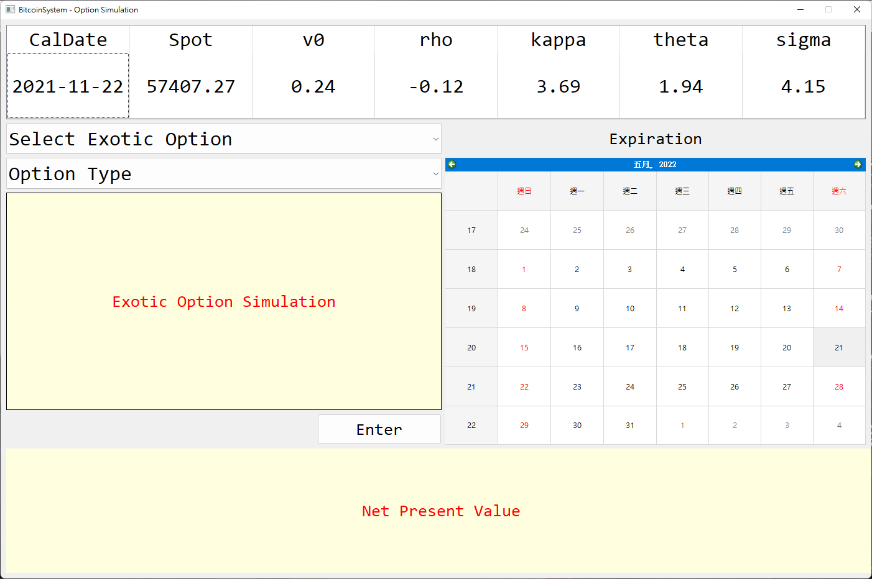
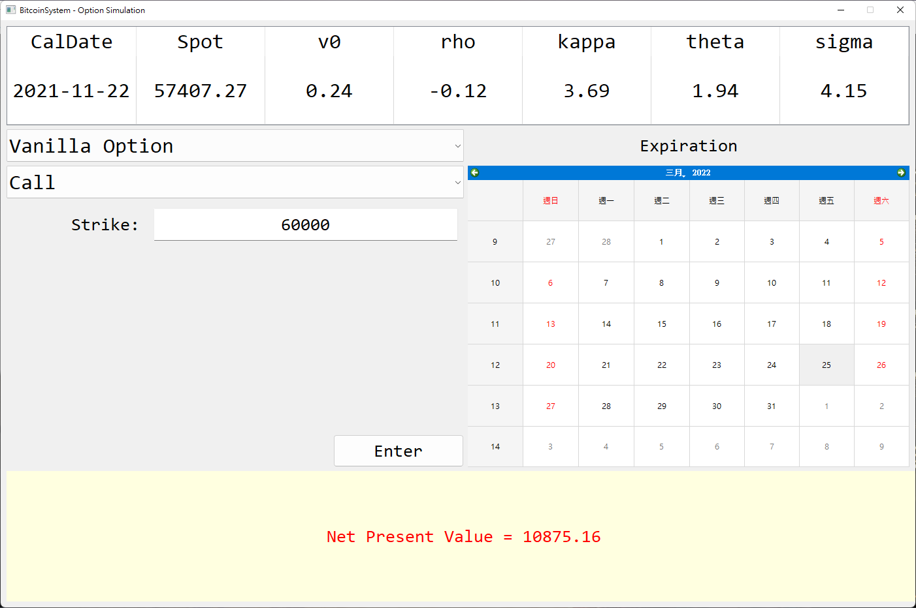
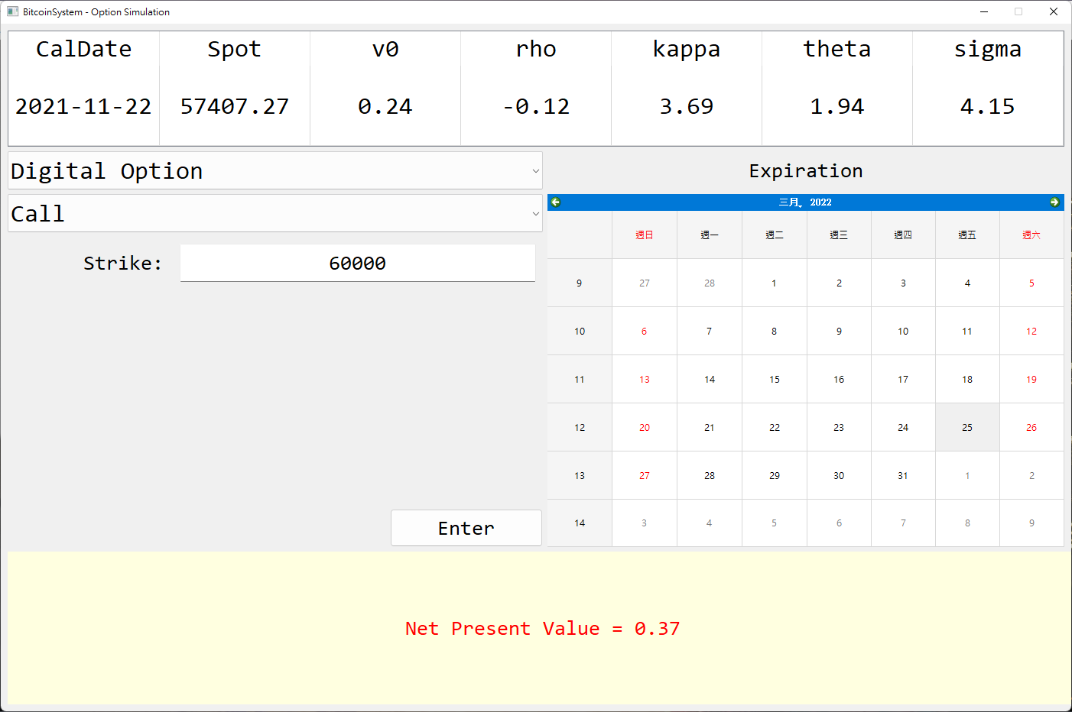
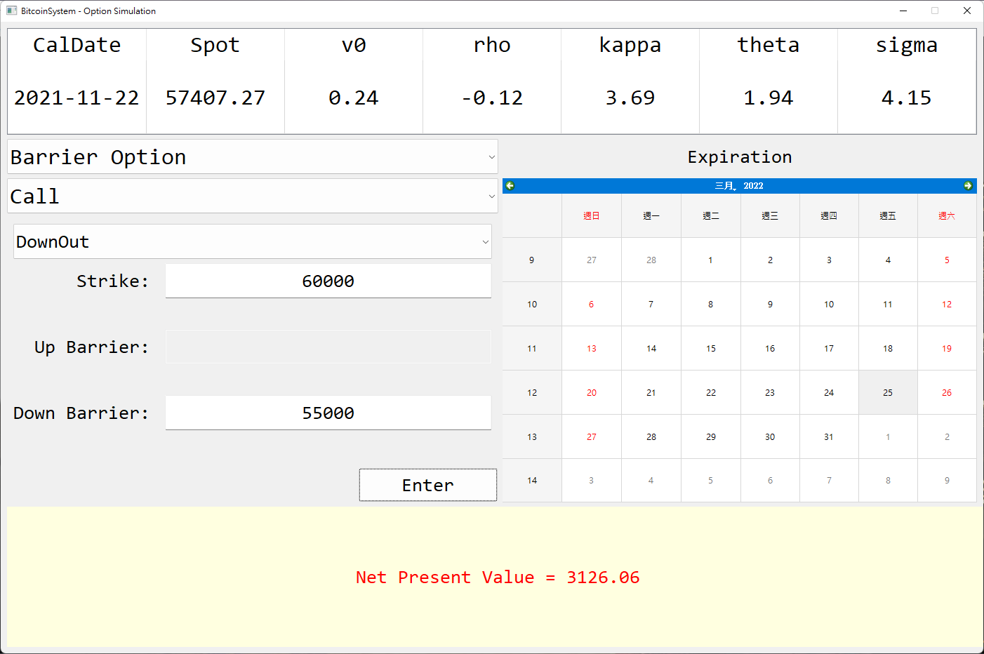

Slide 30
BitcoinSystem - Option Simulation
QTableWidget()
Different exotic option input
QVBoxLayout()
Different exotic option input
QVBoxLayout()
QCalendarWidget()
QLabel()

Slide 31
Summarize
Cryptocurrency and blockchain will become popular traded underlying or assets in the future.
QuantLib is good for options pricing or calibration, etc.
Heston model is much better than Black - Scholes model on Bitcoin assets.
PyQt5 can easily help us to make a GUI.

